Slide 1
AI Lab
Your company is invited to participate.
August 8-10
Santa Clara Convention Center
Presented by

Slide 2
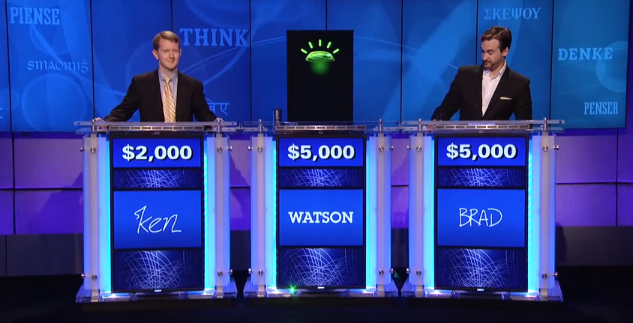
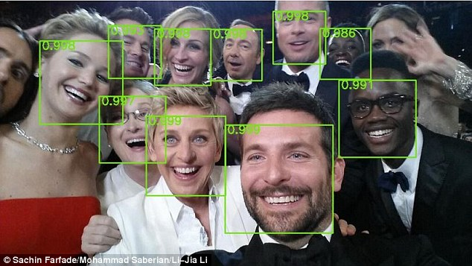
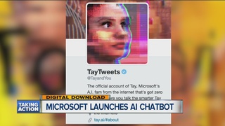
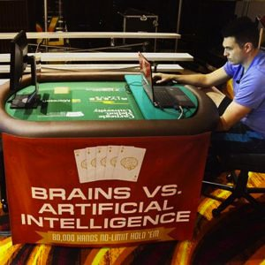
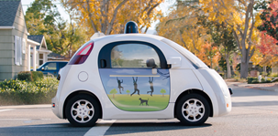
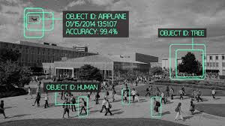

Slide 3
You’re Invited!
The era of artificial intelligence (AI) is upon us, and represents the next big wave in computing. The fastest growing workload in the data center, AI is growing at 2-times the overall computing market. By 2020, more servers will be running data analytics than any other workload, and predictive analytics will be built into every application.
From August 8-10, in the AI Lab inside Flash Memory Summit, over 6,000 attendees will experience a broad range AI applications accessing flash memory inside the server and across the network.
Your company is invited to showcase its offering–at no charge–in the AI Solutions Lab presented by IT Brand Pulse.
To confirm your participation, contact: frank.berry@itbrandpulse.com, 949.300.8917

Slide 4
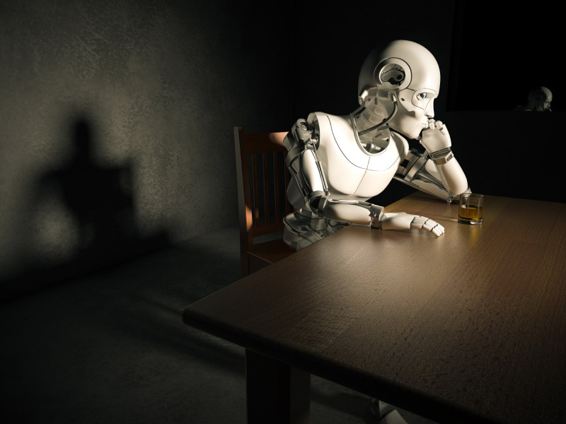
AI Lab Overview
Location
30 x 30 booth area in Santa Clara Convention Center
Set-up
Monday, August 7, 8:00 am–7:00 pm
Display must be completely set up by Noon on Tues., Aug. 8
Exhibit Hall Hours:
Tuesday, August 8, 4:00 pm – 7:00 pm
Wednesday, August 9, 12:00 pm – 7:00 pm
Thursday, August 10, 10:00 am – 2:30 pm
Pre-production products, static displays and live demos are all welcome in the AI Lab
Cost
NO CHARGE FOR EXHIBIT SPACE (rates normally start at $ 4,000 for a 10‘ X 10’ space at FMS, so take advantage of this free display area); Tables to be provided, however exhibitors are responsible for contracting any equipment and/or services at own expense
Exhibitor passes provided by IT Brand Pulse
AI Applications
Chatbots
Education
Engineering
Facial Recognition
Gaming
Healthcare
Marketing
Self-Driving Cars
Security
Speech Recognition
Trading
AI Infrastructure
Servers
Storage
Networking

Slide 5
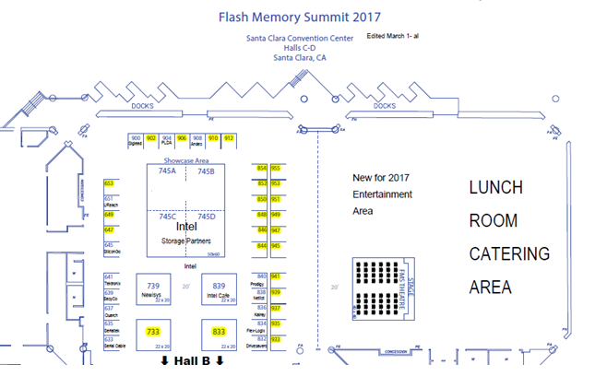
AI Lab Location
AI Lab

Slide 6
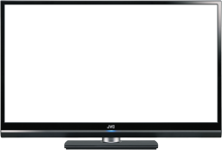
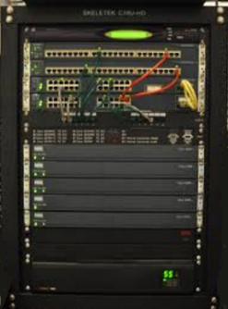
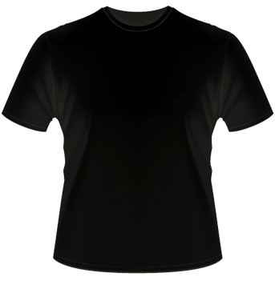
What you can bring
Table-top displays, monitors and signs
Racks
Giveaways
Facial
Recognition
Server w/NVMe SSD

Slide 7
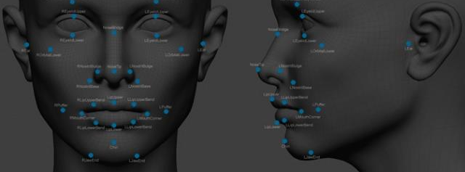
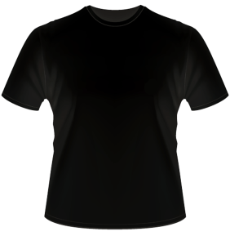
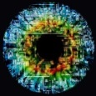
Pre-Event Promotion
Email invitations sent weekly:
To vendors, VARs, end-users, press and analysts
Email invitations available to vendors to forward to their databases
Event information posted to:
flashmemorysummit.com, 2550100.com, and itbrandpulse.com
100 LinkedIn IT pro Groups
Twitter @itbrandpulse.com
Press Release
Tuesday, August 1st
AI. See it. Touch it. Feel it.
In the AI Lab
At Flash Memory Summit
From August 8-10, at the AI Lab inside Flash Memory Summit you will see, touch and feel a broad range of AI applications and infrastructure.
Stop by and get
an AI Lab T-shirt!

Slide 8
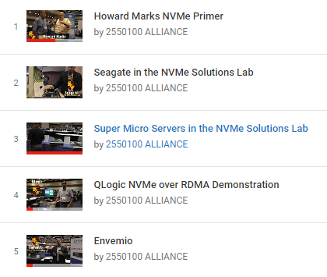
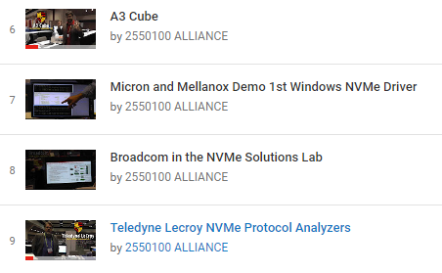
Video Interviews
Promotion of Last Year’s Lab at Flash Memory Summit: NVMe

Slide 9
AI Lab
Reserve your space NOW!
frank.berry@itbrandpulse.com
Presented by

